Slide 1
Introduction to
Object Oriented Programming
CSE 2102
P-000

Slide 2
What is Object Oriented Programming (OOP)
A programming paradigm that uses the concept of "objects" to organize and structure code.
Designs the logic within “Encapsulation”, “Polymorphism”, “Inheritance”
Capsulating Something
Different ways for happening Something
Inheriting Something

Slide 3
C vs Java (Our OOP Stack)
C
A Procedural Programming Language
Java
An Object Oriented programming Language

Slide 4
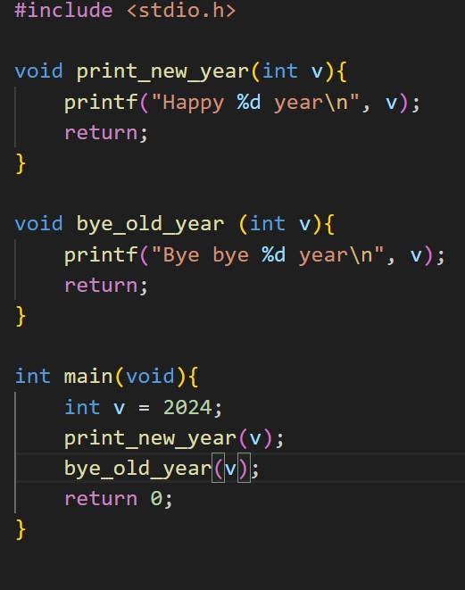
What is Procedural Programming?
We construct different functions (procedures) to write down the instructions
Each function gets a set of data to work on it

Slide 5
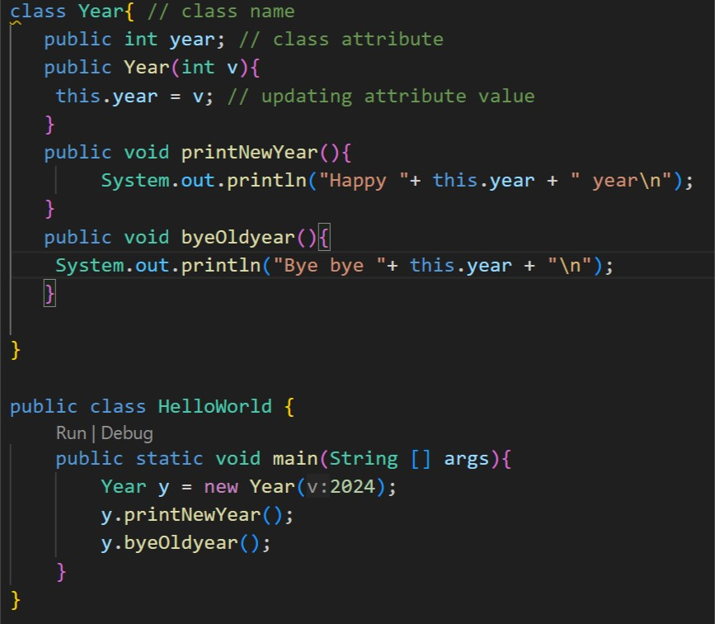
The Idea Behind Object Oriented Programming
We focus on creating objects that encapsulate both data and the functions that operate on that data, as in object-oriented programming (OOP).

Slide 6
Differences?

Slide 7
HelloWorld.java
class Year{ // class name
public int year; // class attribute
public Year(int v){
this.year = v; // updating attribute value
}
public void printNewYear(){
System.out.println("Happy "+ this.year + " year\n");
}
public void byeOldyear(){
System.out.println("Bye bye "+ this.year + "\n");
}
}
public class HelloWorld {
public static void main(String [] args){
Year y = new Year(2024);
y.printNewYear();
y.byeOldyear();
}
}
Access control
encapsulation
Constructor
Method
Main Class
Main Function
Object Creation
Method invoke of an object
Basic code skeleton of a java program

Slide 8
Installation
https://www.java.com/en/download/manual.jsp
https://www3.ntu.edu.sg/home/ehchua/programming/howto/netbeans_howto.html

Slide 9
Code Structure for a single java file
JavaFile.java
JavaFile.class
javac HelloWorld.java
Java HelloWorld

Slide 10
Code Structure for multiple files under a package
// MyClass1.java
package com.example; // package name
public class MyClass1 { // class name
// class implementation
public static void main(String [] args){ // single main function
System.out.println("yes ongoing");
MyClass2 m2 = new MyClass2();
m2.print();
}
}
MyExample
src
com
example
MyClass1.java
MyClass2.java
// MyClass2.java
package com.example;
public class MyClass2 {
// class implementation
public void print(){
System.out.println("printing in class 2");
}
}
javac src/com/example/*.java
cd src
java com.example.MyClass1

Slide 11
Underlying concepts related to OOP (Abstraction)
Abstraction: Hiding the underlying logic in the form of classes
Example: SimpleMath.java
Q1: How Abstraction is playing the roles here? Can you explain?

Slide 12
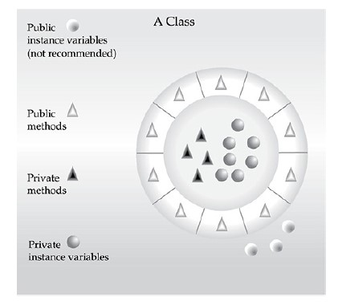
Encapsulation
Encapsulation helps in hiding the internal details of an object and exposing only what is necessary.
Achieved by defining the attributes/methods of a class as private or protected.
External code that interacts with the object faces some constraints in this regard for the communication between

Slide 13
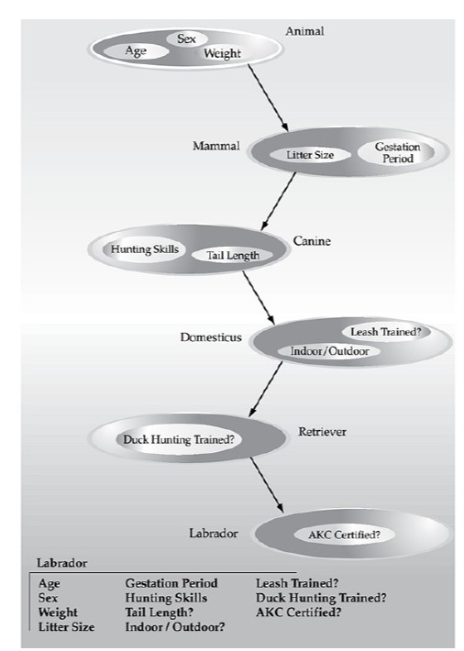
Inheritance
Entity A {
int a;
}
Entity B extends A {
int c;
}
Inheriting the properties of another class
Entity C extends B {
int d;
And inheriting the features of A and B
}

Slide 14
void a (int a, int b) {
…..
}
void a (int a, int b, int c) {
…….
}
Allows objects of different types to be treated as objects of a common type
Two types of polymorphism
Compile Time Polymorphism
Runtime polymorphism
A snapshot of Polymorphism

Slide 15
class Calculator {
int add(int a, int b) {
return a + b;
}
double add(double a, double b) {
return a + b;
}
}
// Superclass
class Animal {
void makeSound() {
System.out.println("Some generic sound");
}
}
// Subclass
class Dog extends Animal {
@Override
void makeSound() {
System.out.println("Woof! Woof!");
}
}
Method Overloading
(During compile time the methods are hooked by the compiler)
Method Overriding
(In runtime based on object which makeSound() will be called is decided

Slide 16
Abstraction
“
Abstraction involves simplifying complex systems by modeling classes based on the essential properties and behaviors they share.
It hides the complex implementation details and focuses on the essential features of an object
”

Slide 17
// Abstract class
abstract class Shape {
int x, y;
// Abstract method
abstract void draw();
// Concrete method
void move(int newX, int newY) {
x = newX;
y = newY;
System.out.println("Shape moved to (" + x + ", " + y + ")");
}
}
// Concrete subclass
class Circle extends Shape {
int radius;
// Implementation of the abstract method
void draw() {
System.out.println("Drawing a circle at (" + x + ", " + y + ") with radius " + radius);
}
}
// Interface
interface Drawable {
void draw();
}
// Concrete class implementing the interface
class Rectangle implements Drawable {
int width, height;
// Implementation of the interface method
public void draw() {
System.out.println("Drawing a rectangle with width " + width + " and height " + height);
}
}

Slide 18
Thank You

